Slide 1
APTITUDE
DATA INTERPRETATION
(LINE TYPE)
SET-1

Slide 2
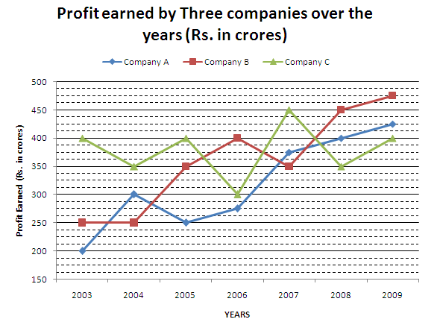
APTITUDE
DATA INTERPRETATION VIDEO-1
Directions (1-5): Study the following graph carefully and answer the questions given below:

Slide 3
APTITUDE
DATA INTERPRETATION VIDEO-1
Q:1. What was the average profit earned by all the three companies in the year 2008?
(a) Rs. 300 crore (b) Rs. 400 crore (c) Rs. 350 crore (d) None of these
Q:2. In which of the following years was the difference between the profits earned by company B and company A the minimum?
(a) 2003 (b) 2004 (c) 2005 (d) None of these
Q:3. In which of the following years was the total profit earned by all three companies together with the highest?
(a) 2004 (b) 2007 (c) 2008 (d) None of these
Q:4. What was the approximate percentage increase in the profit earned by Company A from 2006 to 2007?
(a)36 (b) 24 (c) 40 (d) 20 (e) 54
Q:5. What was the difference between the profit earned by company A in 2004 and the profit earned by company C in 2009?
(a) Rs. 50crore (b) Rs. 1 crore (c) Rs. 100 crore (d) None of these

Slide 4
APTITUDE
DATA INTERPRETATION VIDEO-1
Q:1. What was the average profit earned by all the three companies in the year 2008?
(a) Rs. 300 crore (b) Rs. 400 crore (c) Rs. 350 crore (d) None of these
Q:2. In which of the following years was the difference between the profits earned by company B and company A the minimum?
(a) 2003 (b) 2004 (c) 2005 (d) None of these
Q:3. In which of the following years was the total profit earned by all three companies together with the highest?
(a) 2004 (b) 2007 (c) 2008 (d) None of these
Q:4. What was the approximate percentage increase in the profit earned by Company A from 2006 to 2007?
(a)36 (b) 24 (c) 40 (d) 20 (e) 54
Q:5. What was the difference between the profit earned by company A in 2004 and the profit earned by company C in 2009?
(a) Rs. 50crore (b) Rs. 1 crore (c) Rs. 100 crore (d) None of these

Slide 5
APTITUDE
DATA INTERPRETATION
(LINE TYPE)
SET-2

Slide 6
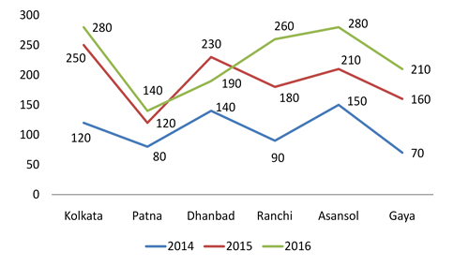
APTITUDE
DATA INTERPRETATION VIDEO-1
Directions (1-4): The given Line graph Data Interpretation Chart shows the sales of shoes (in thousands) from six stores in six different cities Kolkata, Patna, Dhanbad, Ranchi, Asansol, and Gaya during three consecutive years 2014, 2015 and 2016.

Slide 7
APTITUDE
DATA INTERPRETATION VIDEO-1
Q:1. What is the ratio of the total sales of Patna store for three years to the total sales of Asansol store for three years?
33 : 17 b)17 : 33 c) 32 : 17 d)17 : 32 e)None of these
Q:2. Total number of Campus shoes sales on Gaya store and Patna store together for three years is what percent of the total sales of Dhanbad store and Ranchi store together for three years?
71.55% b) 72.75% c) 72.25% d)73.25% e)None of these
Q:3. What percent of the average sales of Campus shoes on Kolkata store, Patna store and Dhanbad store in 2014 is the average sales of Campus shoes on Ranchi store, Asansol store and Gaya store in 2015?
61.81% b) 62.23% c) 62.81% d) 63.43% e) None of these
Q:4. What is the ratio of average sales of Campus shoes of all the stores for the year 2014 to average sales of Campus shoes of all the stores for the year 2015?
23 : 14 b) 14 : 23 c) 13 : 23 d) 23 : 13 e) None of these

Slide 8
APTITUDE
DATA INTERPRETATION VIDEO-1
Q:1. What is the ratio of the total sales of Patna store for three years to the total sales of Asansol store for three years?
33 : 17 b)17 : 33 c) 32 : 17 d)17 : 32 e)None of these
Q:2. Total number of Campus shoes sales on Gaya store and Patna store together for three years is what percent of the total sales of Dhanbad store and Ranchi store together for three years?
71.55% b) 72.75% c) 72.25% d)73.25% e)None of these
Q:3. What percent of the average sales of Campus shoes on Kolkata store, Patna store and Dhanbad store in 2014 is the average sales of Campus shoes on Ranchi store, Asansol store and Gaya store in 2015?
61.81% b) 62.23% c) 62.81% d) 63.43% e) None of these
Q:4. What is the ratio of average sales of Campus shoes of all the stores for the year 2014 to average sales of Campus shoes of all the stores for the year 2015?
23 : 14 b) 14 : 23 c) 13 : 23 d) 23 : 13 e) None of these

Slide 9
APTITUDE
DATA INTERPRETATION
(LINE TYPE)
SET-3

Slide 10
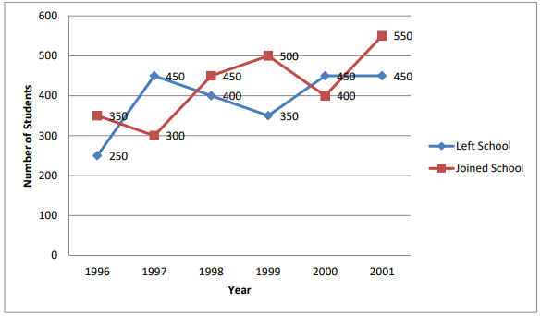
APTITUDE
DATA INTERPRETATION VIDEO-1
Directions (1-5): Study the following line graph which gives the number of students who joined and left the school in the beginning of the year for six years from 1996 to 2001. Initial strength of the school in 1995 was 3000
Answer questions based on the line graph given below

Slide 11
APTITUDE
DATA INTERPRETATION VIDEO-1
Q:1.The strength of the school inc./dec. from 1997 to 1998 by what percent ?
1.7% b) 1.8% c) 1.9% d) 2%
Q:2.The number of students studying in the school during 1999 was
3100 b) 3000 c) 3150 d) 3250
Q:3.During which of the following pairs of years, the strength of the school was same ?
1997 and 1998 b) 1998 and 2000 c) 1999 and 2001 d) 1996 and 2000
Q:4.The number of students studying in the school in 1998 was what percent of the number of students studying in the school in 2001 ?
90.75% b) 91.75% c) 92.75% d) 93.75%
Q:5.Among the given years the largest number of students joined in which year ?
a) 1999 b) 2000 c) 2001 d) 1998

Slide 12
APTITUDE
DATA INTERPRETATION VIDEO-1
Q:1.The strength of the school inc./dec. from 1997 to 1998 by what percent ?
1.7% b) 1.8% c) 1.9% d) 2%
Q:2.The number of students studying in the school during 1999 was
3100 b) 3000 c) 3150 d) 3250
Q:3.During which of the following pairs of years, the strength of the school was same ?
1997 and 1998 b) 1998 and 2000 c) 1999 and 2001 d) 1996 and 2000
Q:4.The number of students studying in the school in 1998 was what percent of the number of students studying in the school in 2001 ?
90.75% b) 91.75% c) 92.75% d) 93.75%
Q:5.Among the given years the largest number of students joined in which year ?
a) 1999 b) 2000 c) 2001 d) 1998

Slide 13
APTITUDE
DATA INTERPRETATION
(LINE TYPE)
SET-4

Slide 14
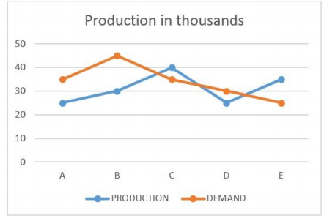
APTITUDE
DATA INTERPRETATION VIDEO-1
Directions (Q. 1 -5) : Study the following line graph carefully and answer the questions
Accordingly. Following graph gives the demand and production of mobile phones of five companies A, B, C, D and E

Slide 15
APTITUDE
DATA INTERPRETATION VIDEO-1
Q:1.The production of company B is approximately what percent of the demand?
71.4% b) 85% c) 140% d) 66.67%
Q:2.What is the average production of mobile phones by all the companies?
3100 b) 25000 c) 26000 d) 31000
Q:3.The production of mobile phones by company C is the same as the production of which of the following pairs of the companies?
A and D b) none c) D and E d) B and A
Q:4.The demand of company E is approximately what percent of the demand of company D?
30% b) 65% c) 83.3% d) 40%
Q:5.To meet its demand the company A wishes to buy the surplus mobile phones from a single company. Which of the following companies can supply?
a) B b) C c) D d) E

Slide 16
APTITUDE
DATA INTERPRETATION VIDEO-1
Q:1.The production of company B is approximately what percent of the demand?
71.4% b) 85% c) 140% d) 66.67%
Q:2.What is the average production of mobile phones by all the companies?
3100 b) 25000 c) 26000 d) 31000
Q:3.The production of mobile phones by company C is the same as the production of which of the following pairs of the companies?
A and D b) none c) D and E d) B and A
Q:4.The demand of company E is approximately what percent of the demand of company D?
30% b) 65% c) 83.3% d) 40%
Q:5.To meet its demand the company A wishes to buy the surplus mobile phones from a single company. Which of the following companies can supply?
a) B b) C c) D d) E

Slide 17
LOGICAL REASONING
THANK YOU

